Slide 1



TEAM NAME:
PROPHECY

Slide 2
Problem Statement
Build a solution to predict credit worthiness of individuals using social media analytics.
Description : This solution aims at leveraging social network features of individuals on social media platform (Ex. followers, text posts) along with individual credit history with financial institutions (Ex. credit record <Good or Bad>, loan amt, loan duration etc.) to build a solution that predict credit/loan worthiness of individuals.
Following presumptions are used to build this solution.
Social Network features such as followers on twitter reflect on social/economical status, social connections of individuals which could impact their capability to repay loans.
Mean polarity (+ve/-ve sentiment) of text posts on social media platform could reflect on human personality of an individual therefore it could impact his capability to repay a loan.

Slide 3
Describe your solution
Transformation Flow
Credit History Dataset (Credit record status, Loan amt, Loan Months, Age , Job Type, Job Years etc.)
Final Feature vector
Feature Encoding , Tuning and Test Train split
Gradient Boosting Classifier
Prediction on Credit record status (Good or Bad)
Twitter Profile Dataset (User, Followers, Following )
Twitter Text Dataset (Text Posts, Date, User ID)
Calculate Mean polarity of text posts
Technology Stack used
Python
Gradient Boosting Classifier
Sentiment Analysis
SkLearn ML Library

Slide 4
Use Cases & Business Value of the solution
Solution could be used to leverage social media information accessible for loan applicants along with available credit request information to predict their loan default or solvency probability.
Solution could be used to do comparative analysis of different social and credit request features that impacts credit worthiness of loan requesters.
Solution could be used as a basis to further study social network features such as image posts, social connections as having impact on credit worthiness of individuals.

Slide 5
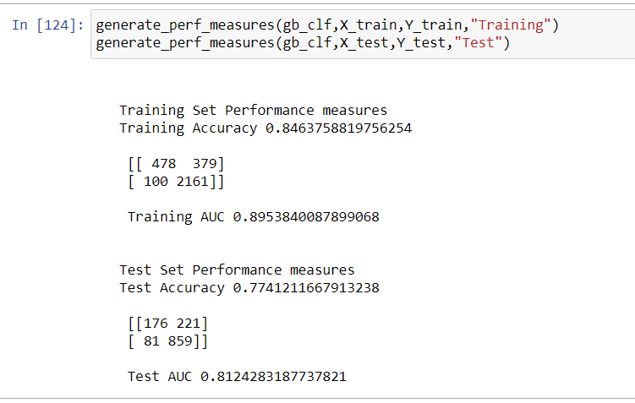
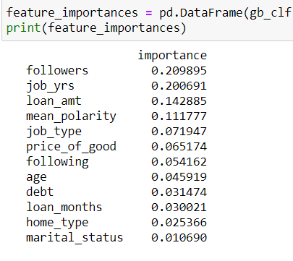
What was accomplished
Model test result of Gradient Boosting Classifier
Feature importance
https://github.com/Prophecy-lti-hackathon/LTI-hackathon

Slide 6
Challenges & Learnings
Challenges:
Exploration of different datasets.
Learnings:
Feature encoding of different credit features.
Ensemble methods to improve accuracy.
Research Document Link: https://ink.library.smu.edu.sg/cgi/viewcontent.cgi?article=4456&context=sis_research

Slide 7
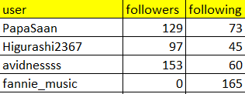
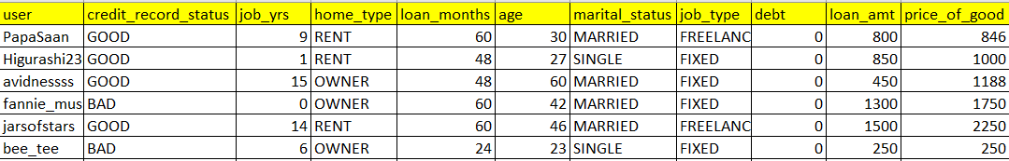
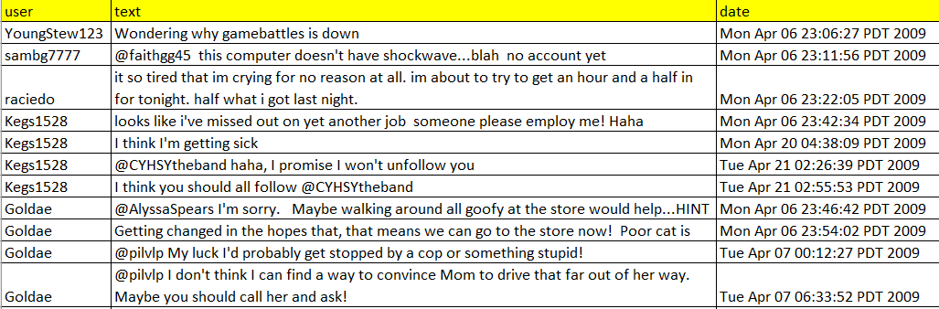
Snapshot of Source data sets
twitter_profile.csv
credit_history.csv
twitter_text.csv

